Slide 1

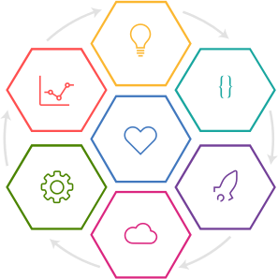
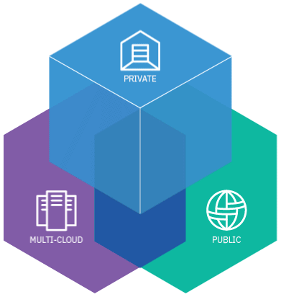
IBM Point of View:
DevOps & Cloud Native Development
DevOps is a fundamental part of our opinionated modern day delivery methodology…
£270.48
£270.48
The cloud is the modern platform for modern architectures and applications…

Slide 2
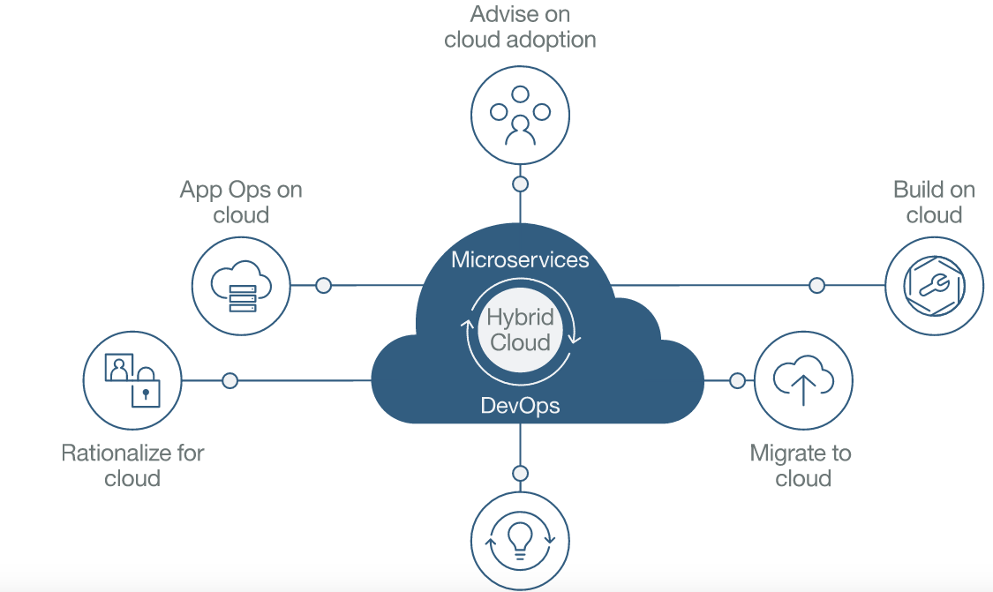
What is Cloud Innovate?
THE SETUP
Cloud Innovate practices provide a complete set of services enabling our clients’ to have applications and ecosystems that coexist, including cloud native, cloud ready, or hybrid traditional.
We have brought together the thought leadership for visioning, deep expertise for execution and modern application development services for hybrid IT environments, underpinned by IBM innovation.
IBM Method for Cloud Transformation
The rapid evolution of technology is compelling clients and their industries to transform. Clients who embrace cloud, cognitive, social, mobile, IoT, Blockchain, and other emerging technologies are innovating their business and process models. They’re finding new ways to enhance customer centricity, and harness their ecosystems for growth.
Modernize
For cloud
Modern practices for modern enterprises
Modern practices for modern enterprises

Slide 3
IBM Cloud Garage Method
Think Conceptualization, refinement, and prioritization of capabilities
Learn Continuously learn based on outcomes from experiments
Code Generation, enhancement, optimization and testing of features
Culture Foundational values and principles
Manage Ongoing monitoring, support, and recovery of offerings
Deliver Automated production and delivery of offerings
Combining industry best practices for Design Thinking, Lean Startup, Agile Development, DevOps, and Cloud to build and deliver innovative solutions.
Run Services, options, and capabilities required to run in the Cloud
Modern delivery practices , behaviors, architectures,
for modern applications
To learn more visit: https://www.ibm.com/devops/method
Notes:
IBM’s practical method combines the best of open communities, Design Thinking, Lean Startup, with an agile DevOps methodology. An open and repeatable method with best practices, tool chains and a thriving ecosystem. Provides:
Hardened method-ware, delivered as digital experience and practice library of work-product assets.
Accelerators to speed adoption, combining tool chains and methods.
Shared learning (videos, case studies, blogs) of IBM transformation; extends to clients, phase 2.
Open community forum to engage, comment, progress and extend methodology.

Slide 4
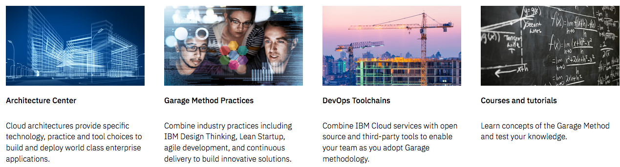

A Holistic Approach to Modern Delivery
Get technical →
Adopt the practices →
Start developing →
Build skills →
Toolchains can be hosted on any cloud, and deploy to any cloud (including IBM Cloud Private)
Microservices & APIs
Microservices & APIs

Slide 5
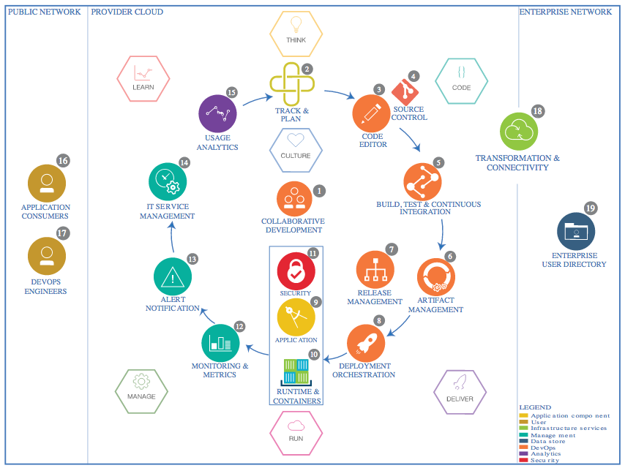
IBM DevOps Reference Architecture
IBM’s opinionated architecture that can address delivery of cloud native, cloud ready and hybrid traditional applications to public, private, and hybrid clouds.
https://www.ibm.com/cloud/garage/architectures/devOpsArchitecture/reference-architecture
Microservices & APIs
Microservices & APIs

Slide 6
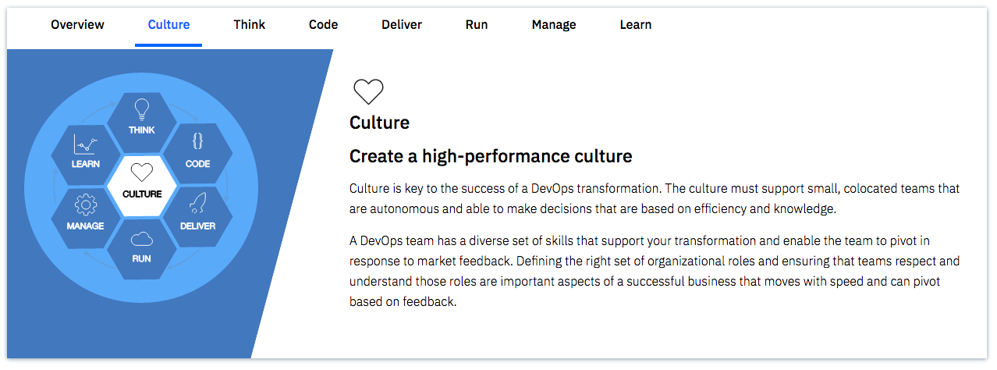
Culture…the lynchpin of success
Team structures must change.
New roles must be formed.
New behaviors must be learned and practiced.
Liberties must be ceded back to teams…to unleash them.
Microservices & APIs
Microservices & APIs

Slide 7
Modern platforms,
Modern architectural styles

Slide 8

Cloud Native Development
Microservices and APIs are
the modern day architectural style, which leverage cloud platforms
The availability of cloud platforms, virtualization advancements, and the emergence of Agile and DevOps practices has thoroughly upended traditional software development practices. Not only that, but traditional monolithic applications (including their supporting infrastructure) were not built to take advantage of flexible cloud resources.
Microservices, as an architecture, describes an approach to building complex applications using independent, replaceable processes. These processes are single-purpose, with a small scope. They communicate with other services using lightweight APIs and language-agnostic protocols. These independent processes are also called microservices.
Separating the bits of an application into pieces can be very freeing, and it is easy to appreciate from a quick skim how isolating each piece of an application would reduce the overhead involved in making changes, and how it would reduce the risk around trying something new. But this approach does not come without pitfalls of its own: distributed systems are not a trivial problem space to build in.
https://developer.ibm.com/cloud-microservices/
Microservices & APIs
Microservices & APIs

Slide 9
Core Ingredients
There is no magic around microservices. These tidy little services can become a spaghetti mess just like software built with any other approach. Both thinking and team organization need to change to make microservices successful.
Microservices are independent. Agility is one of the benefits of microservice architectures, but it only exists when services are capable of being completely re-written without disturbing other services. That isn’t likely to happen often, but it explains the requirement. Clear API boundaries give the team working on a service the most flexibility to evolve the implementation. This characteristic is what enables polyglot programming and persistence.
Microservices are resilient. Overall application stability depends on individual microservices being robust to failure. This is a big difference from traditional architectures, where the supporting infrastructure handled failures for you. Each service needs to apply isolation patterns like circuit breakers and bulkheads to contain downstream failures and define appropriate fallback behaviors to protect upstream services.
Microservices are stateless, transient processes. This is not the same as saying microservices can’t have state! It does mean that state should be stored in external backing cloud services, like Redis, rather than in-memory. Fast startup and graceful shutdown behavior further allows microservices to work well with automated orchestrators that create and destroy instances in response to load.
https://developer.ibm.com/cloud-microservices/

Slide 10
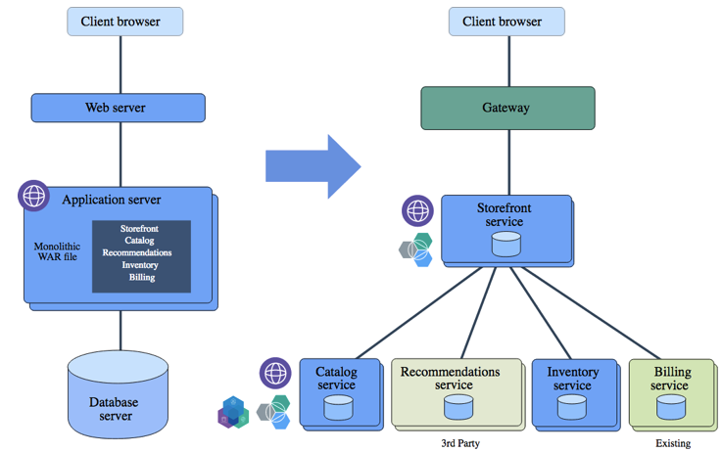
Why is DevOps essential?
THE BREAKDOWN
“monolith” style
microservice style
✓ deploy
✓ deploy
transform
By their very nature, microservices will have more deployments, due to the increase in componentization and change volume.
Without automation in the delivery lifecycle, microservices can quickly become an unmanageable IT endeavor.
✓ deploy
✓ deploy
✓ deploy
Notes:
Diagram from the IBM Microservices References Architecture: https://www.ibm.com/cloud/garage/content/architecture/microservices/0_1
Cloud Innovate: http://cloudinnovate.w3ibm.mybluemix.net/

Slide 11

Controlling Chaos (with DevOps)
By definition, applications that use microservices have lots of moving parts. Automated tools make the difference between a flexible, scalable, and yet stable system, and an unmanageable mess.
Continuous integration and deployment (CI/CD) pipelines are the base upon which a microservices application is built. Unique pipelines per service ensures that services can evolve at their own pace. The ideal is for any given built instance to transition through stages of a pipeline for eventual deployment into production without requiring any code changes along the way.
Containers are a big help with CI/CD, as they naturally define the entire operating environment for the service. Using containers goes a long way towards eliminating those hard-to-spot differences between development and production environments, which are a common source of last-minute deployment surprises.
Different services will have different scaling requirements: a catalog service on black friday is going to use resources very differently than an account service, for example. CI/CD pipelines perform a role in defining per-service scaling policies as they automate deployment into different environments. Orchestration can then use those policies to manage routing and load balancing accordingly.
https://developer.ibm.com/cloud-microservices/

Slide 12
Culture Shock
Culture Foundational values and principles
There is a huge cultural component to microservices. Conway’s law is often cited for a valid reason: organizational structure does influence how software is built.
As an example, if an organization is divided so that application developers are separate from database administrators, the resulting architecture will have distinct tiers: a tier optimized for application code, and a data tier that is optimal for database administrators. Application changes that require database changes have to then be coordinated between the two distinct groups. That should sound familiar.
To build truly independent microservices, each service needs to be owned, maintained, and operated by a single team. From cradle to grave and at all stages in-between, that team owns the details of how the service works. There will be some coordination required with other teams, but that coordination should be at the surface level. For the curious, this is where domain-driven design enters the conversation. Clearly defined, versioned APIs that use language-agnostic protocols will go a long way to keeping coordination required between teams focused on the important external characteristics of the service, and away from the internal details, which should remain free to change at any time.
https://developer.ibm.com/cloud-microservices/

Slide 13
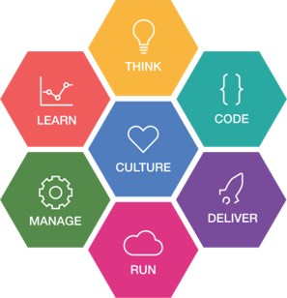



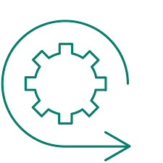
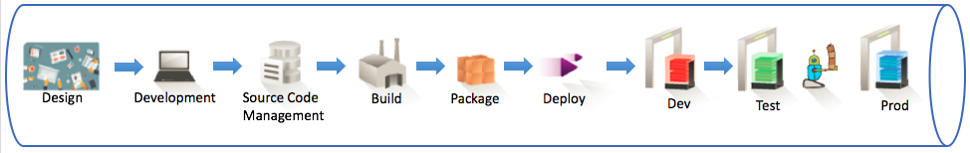

Release Strategy
Release Strategy
Releases are comprised of sets of loosely coupled microservices, delivered by multi-disciplinary squads, leveraging automation, virtualization, instrumentation, pervasive testing, and a high degree of collaboration
Successful release strategies employ guiding principles:
Culture of Agile, DevOps, Design Thinking, Lean
Multi-disciplinary Squads, responsible for lifecycle delivery (Developers code, test, deploy, debug, maintain)
12 Factor App – tenants that apply specifically to DevOps and delivery
Codebase – 1 code repo/microservice
Build, Release, Run — a discrete separation of each phase in delivery
Disposability – capability to tear down and spin up microservices simply and quickly
Dev/Prod Parity – minimization of variance between development and production environments
1 toolchain instantiation per microservice
Bounded business context with well-formed APIs (contracts)
Multi-speed IT enablement (service virtualization, API testing; Test early, test often)
Blue-Green Deployment, Dark Launches, Feature Toggles
IBM Cloud Garage Method
12 Factor App
(with DevOps-related tenants):
Codebase
Dependencies
Config
Backing Services
Build, release, run
Processes
Port binding
Concurrency
Disposability
Dev/prod parity
Logs
Admin Processes
Service virtualization unleashes
multi-speed IT
Squad
Product
Owner
Anchor
Microservice
Developer
Site
Reliability
Engineer
green
Microservices with bounded business context,
and well-defined APIs
router
Microservice
Developer
blue
Pipeline
Engineer
A ”continuous delivery” toolchain, addressing unique microservice characteristics
Squad
Leader
UX
Developer
Blue Green Deployment,
Dark Launch & Feature Toggle
approaches mitigate cutover and new feature risk

Slide 14
Code Quality Monitoring and Management
Code Quality Monitoring and Management
Without consideration for code quality, service monitoring, or management, iterative continuous delivery of microservices can lead to:
more defects
delayed integration
slower end-to-end delivery
lower quality
more risk
Mitigate risk in delivery with good microservice design practices (12 Factor App), continuous static and dynamic testing, and a culture of continuous feedback and optimization.
Implement Observability Patterns *
Enable granular and dynamic monitoring by designing microservices with:
Log aggregation
Application metrics
Audit logging
Distributed tracing
Exception tracking
Health check API
Logging deployments and changes
Test Source Quality
Infuse static analysis tools in the pipeline to scour source code to encourage implementation of leading practices (12 Factor App).
Is there at least 1 API?
Is there a health check endpoint defined?
Is the code stateless?
Are configurations externalized?
Test Code Resiliency
“Force Fail” runtime microservices, to observe behavior on failure conditions.
Is the circuit-breaker pattern implemented?
Do the observability patterns implemented assist in problem determination?
Improve Code Quality
Refactor microservice to address defects in design, source code, and behavior.
Notes:
* http://microservices.io/patterns/observability/application-logging.html

Slide 15
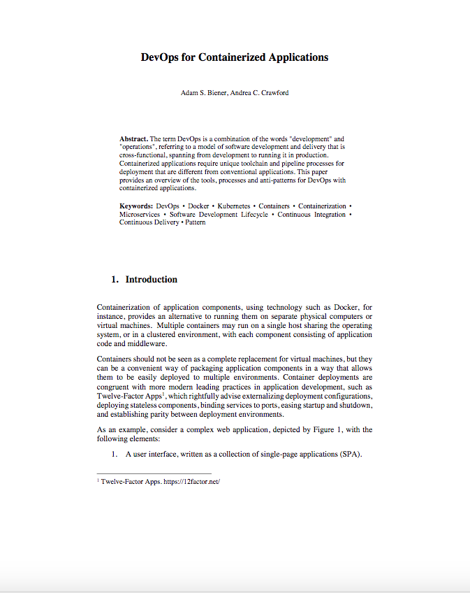
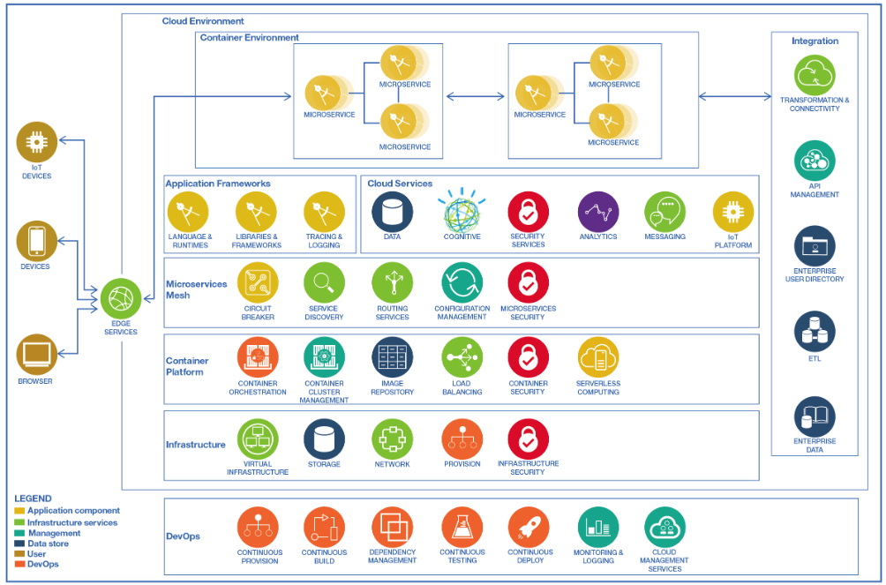
Deployment Patterns & Service Management Decisions
Deployment Patterns and Service Management
By their nature, microservices outnumber their monolith equivalents, and are best hosted on elastic, commoditized, disposable environments driven by configurable policies and event-driven conditions.
Enabling technologies include:
Container & Cluster Management platforms (Docker, Cloud Foundry)
”Serverless Computing” (IBM Cloud Functions, AWS Lambda)
Well designed microservices adhere to 12 Factor App tenants and should exploit a service mesh and coding frameworks to accelerate development and manage runtime behavior of microservices.
Enabling technologies include:
Istio
Netflix OSS
Spring Boot
DevOps for Containerized Applications:
A day in the life
IBM Microservices Reference Architecture
Service Management Considerations for Microservices:
Leverage circuit-breaker pattern to bake in greater fault tolerance and graceful exits into code
Exploit “observability” patterns to enable visibility and traceability of service runtimes
Leverage auto-scaling policies, to dynamically address workload peaks and valleys
Routinely deploy chaos testing to validate and tune fault tolerance of the microservice ecosystem
Use “Blue Green” deployments to eliminate risk of outage during release cutover
Cut cost and risk with runbook automation for common tasks

Slide 16
Responsive Operations
Responsive Operations
Continuous feedback, learning, and optimization is critical in landscape with more moving parts (microservices)
In today's global marketplace, websites are expected to be always available.
1
2
3
4
Optimize Delivery with a DevOps Dashboard
A DevOps Dashboard tracks and measures velocity and quality of release trains (Design through Deploy)
Identify bottlenecks (commonly found in build, test, and deploy)
Identify quality issues
Introduce and refine automation
Track and measure incremental delivery progress and value
Enrich User Experiences with Runtime Analysis
Inspect runtime dynamics of microservices to understand memory, I/O, workload, runtime container behavior. Based on runtime behavior, tune/refactor microservice.
Microservice is invoked often, adjust horizontal scale policy
Microservice is not invoked often, deploy using “server-less compute”
Microservice uses a lot of I/O, rewrite using Node.js
Harden with Chaos Testing and Runbooks
Build a culture of reliability with chaos testing.
Unleash random ”take-down” tests to ensure disposability
Leverage health check API’s to test and monitor
Infuse runbook automation to handle common tasks
Make Visibility
and Accountability Easy
Operations is the responsibility of all squad members.
Instrument the delivery pipeline with tools (i.e. PagerDuty, Slack) focused on real time collaboration and communication

Slide 17


